Slide 1
Operating Systems Sub Code:18CS43
Faculty Name : Sougandhika Narayan
Asst. Professor, Department of CSE
KSIT, Bangalore

Slide 2
File System Implementation
File-System Structure
File-System Implementation
Directory Implementation
Allocation Methods
Free-Space Management

Slide 3
File-System Structure
File structure
Logical storage unit
Collection of related information
File system organized into layers
File system resides on secondary storage (disks)
Provides efficient and convenient access to disk by allowing data to be stored, located retrieved easily
File control block – storage structure consisting of information about a file
Device driver controls the physical device

Slide 4
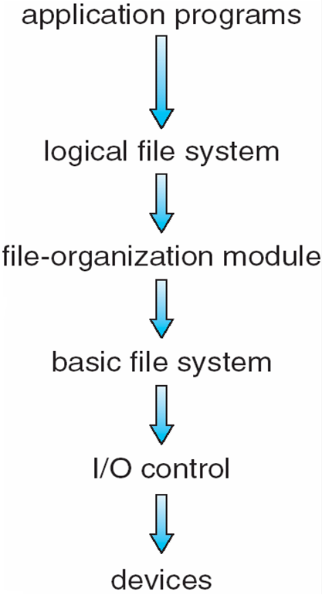
Layered File System

Slide 5
I/O control consists of device drivers and interrupt handlers to transfer information between main memory and the disk system.
Basic file system needs to issue generic commands to appropriate device driver to read and write physical blocks on the disk.
File-organization module knows about files and their logical blocks as well as physical blocks.
Logical file system manages meta data information. Metadata includes all of the file-system structure except the actual data.
File-Control Block contains information about the file, including ownership, permissions and location of the file contents.

Slide 6
File-System Implementation
Boot control block contains info needed by system to boot OS from that volume
Volume control block contains volume details
Directory structure organizes the files
Per-file File Control Block (FCB) contains many details about the file

Slide 7
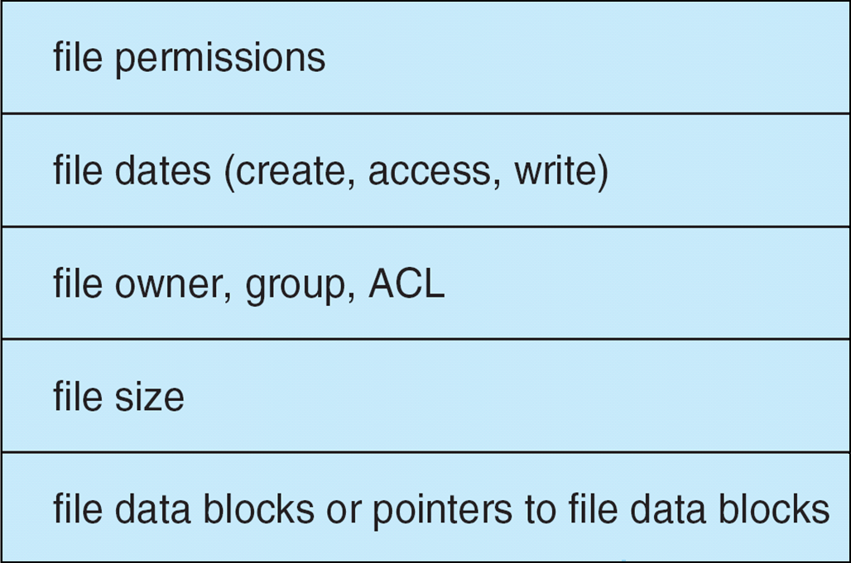
A Typical File Control Block

Slide 8
In-Memory File System Structures
The following figure illustrates the necessary file system structures provided by the operating systems.
Figure (a) refers to opening a file.
Figure (b) refers to reading a file.

Slide 9
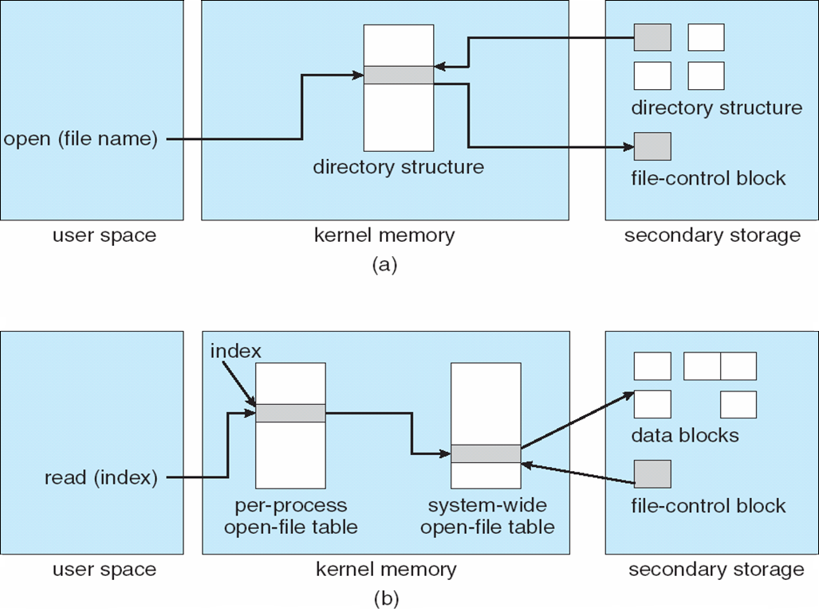
In-Memory File System Structures

Slide 10
Virtual File Systems
Virtual File Systems (VFS) provide an object-oriented way of implementing file systems.
VFS allows the same system call interface (the API) to be used for different types of file systems.
The API is to the VFS interface, rather than any specific type of file system.

Slide 11
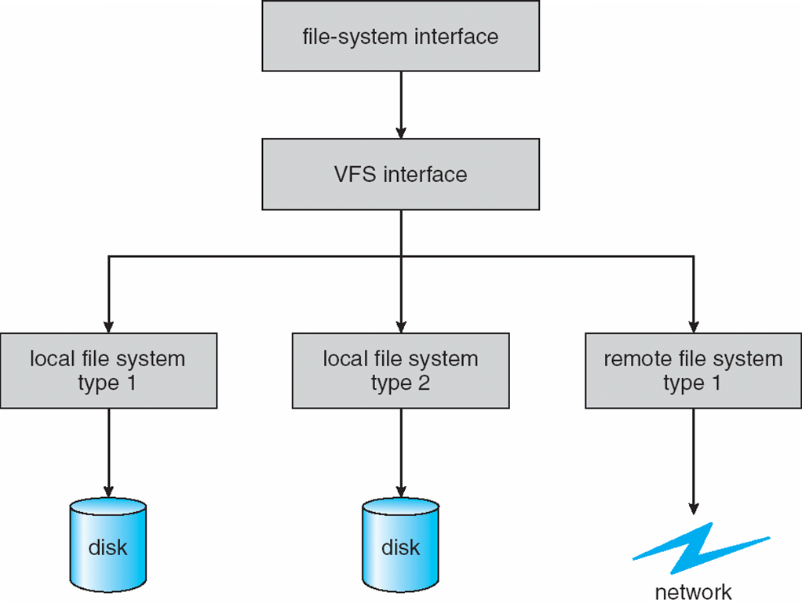
Schematic View of Virtual File System

Slide 12
Directory Implementation
Linear list of file names with pointer to the data blocks.
simple to program
time-consuming to execute
Hash Table – linear list with hash data structure.
decreases directory search time
collisions – situations where two file names hash to the same location
fixed size

Slide 13
Allocation Methods
An allocation method refers to how disk blocks are allocated for files:
Contiguous allocation
Linked allocation
Indexed allocation

Slide 14
Contiguous Allocation
Each file occupies a set of contiguous blocks on the disk
Simple – only starting location (block #) and length (number of blocks) are required
Random access
Wasteful of space (dynamic storage-allocation problem)
Files cannot grow

Slide 15
Contiguous Allocation
Mapping from logical to physical
Q
LA/512
R
Block to be accessed = ! + starting address
Displacement into block = R

Slide 16
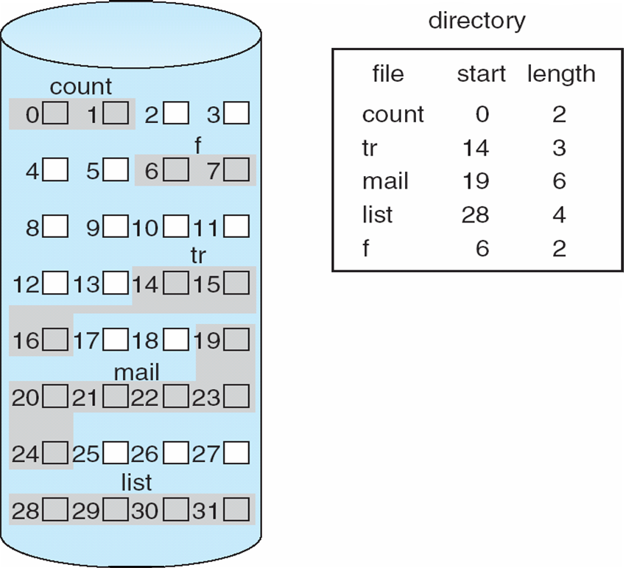

Slide 17
Extent-Based Systems
Many newer file systems (I.e. Veritas File System) use a modified contiguous allocation scheme
Extent-based file systems allocate disk blocks in extents
An extent is a contiguous block of disks
Extents are allocated for file allocation
A file consists of one or more extents

Slide 18
Linked Allocation
Each file is a linked list of disk blocks: blocks may be scattered anywhere on the disk.
block =
pointer

Slide 19
Linked Allocation (Cont.)
Simple – need only starting address
Free-space management system – no waste of space
No random access
Mapping
Q
LA/511
R
Block to be accessed is the Qth block in the linked chain of blocks representing the file.
Displacement into block = R + 1
File-allocation table (FAT) – disk-space allocation used by MS-DOS and OS/2.

Slide 20
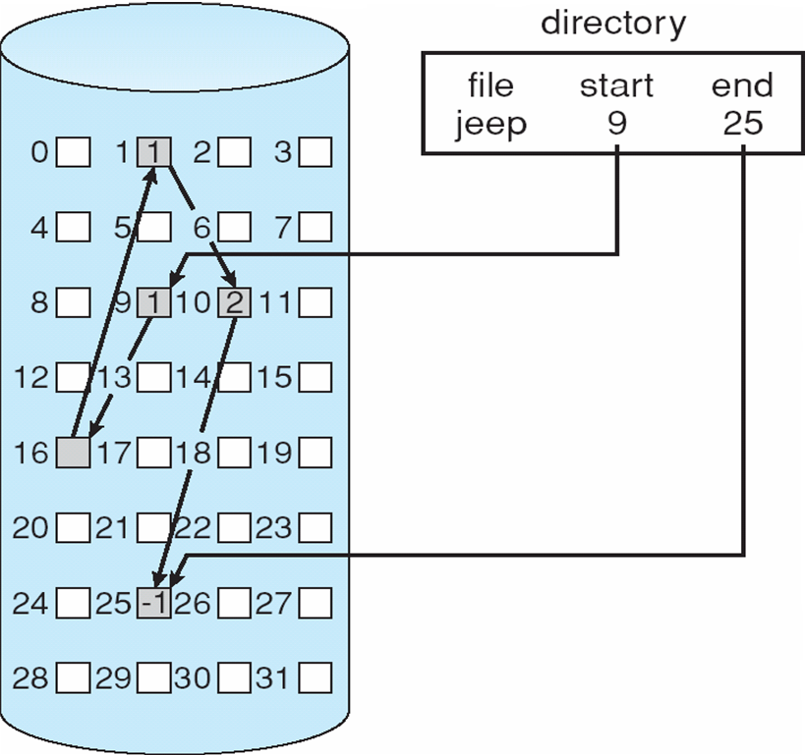
Linked Allocation

Slide 21
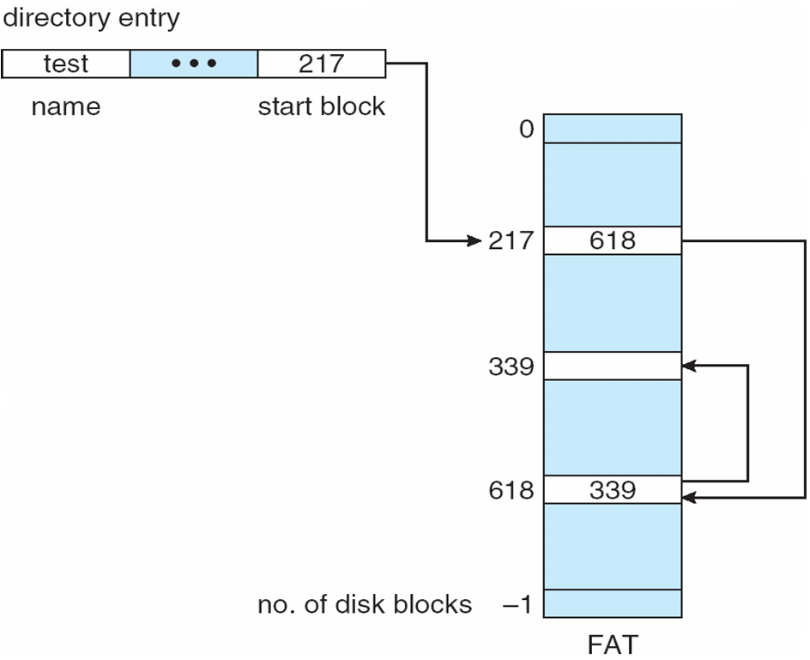
File-Allocation Table

Slide 22
Indexed Allocation
Brings all pointers together into the index block
Logical view

Slide 23
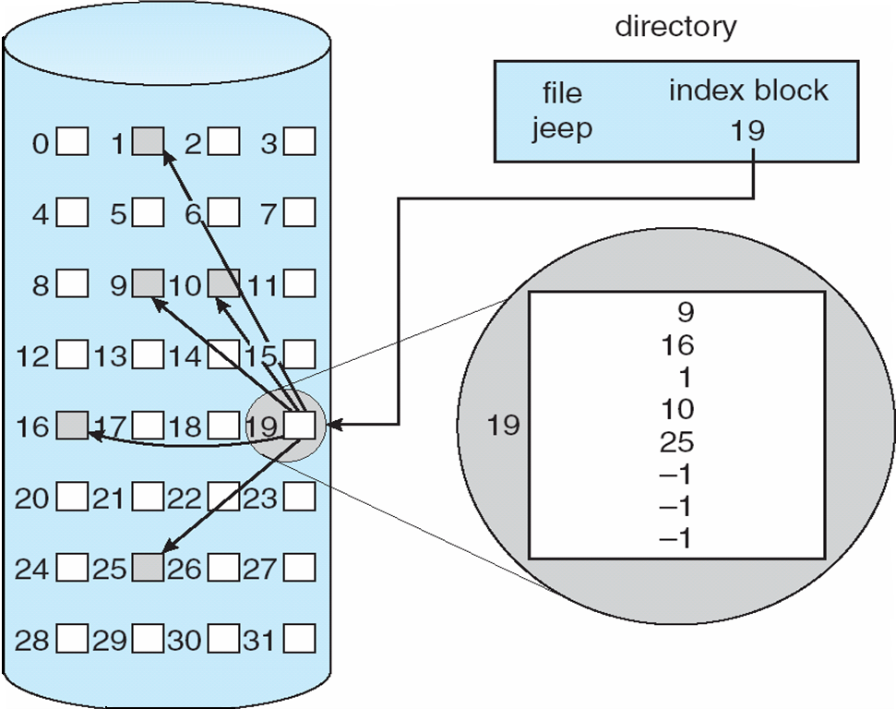
Example of Indexed Allocation

Slide 24
Indexed Allocation (Cont.)
Need index table
Random access
Dynamic access without external fragmentation, but have overhead of index block
Mapping from logical to physical in a file of maximum size of 256K words and block size of 512 words. We need only 1 block for index table
Q
LA/512
R
Q = displacement into index table
R = displacement into block

Slide 25
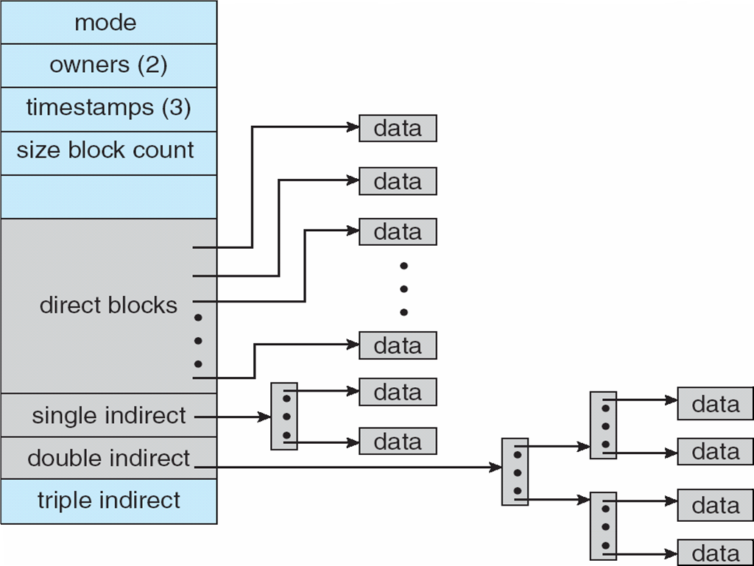
Indexed Allocation – Mapping (Cont.)

Slide 26
Free-Space Management
Bit vector (n blocks)
n-1
…
0
1
2
bit[i] =

0 ⇒ block[i] free
1 ⇒ block[i] occupied
Block number calculation =
(number of bits per word) *
(number of 0-value words) +
offset of first 1 bit

Slide 27
Free-Space Management (Cont.)
Bit map requires extra space
Example:
block size = 2¹² bytes
disk size = 2³⁰ bytes (1 gigabyte)
n = 2³⁰/2¹² = 2¹⁸ bits (or 32K bytes)
Easy to get contiguous files
Linked list (free list)
Cannot get contiguous space easily
No waste of space
Grouping
Counting

Slide 28
Free-Space Management (Cont.)
Need to protect:
Pointer to free list
Bit map
Must be kept on disk
Copy in memory and disk may differ
Cannot allow for block[i] to have a situation where bit[i] = 1 in memory and bit[i] = 0 on disk
Solution:
Set bit[i] = 1 in disk
Allocate block[i]
Set bit[i] = 1 in memory

Slide 29
Directory Implementation
Linear list of file names with pointer to the data blocks
simple to program
time-consuming to execute
Hash Table – linear list with hash data structure
decreases directory search time
collisions – situations where two file names hash to the same location
fixed size

Slide 30
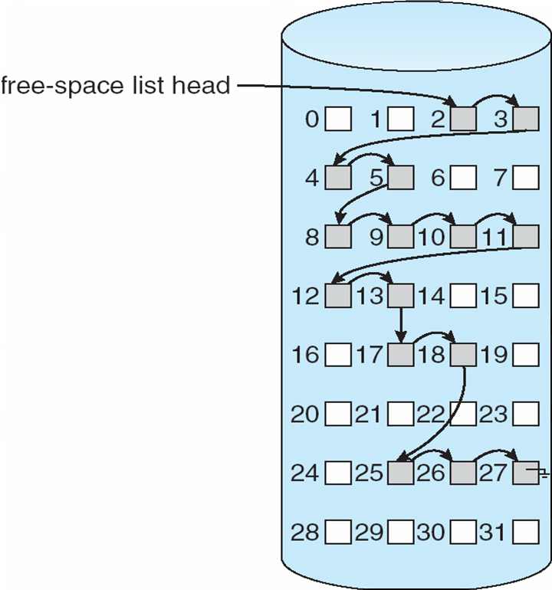
Linked Free Space List on Disk

